Slide 1
Architect School
Web UI/CSS
June 7, 2011
DRAFT: For Discussion Purposes Only

Slide 2
The UI is the project (in the mind of the user)
Fear
The UI of the web application is what the client interacts with daily
Without a clean, fast, and efficient user interface the project will be a failure in the mind of the customer, no matter how elegant the underlying code
Creating a decent user interface requires planning and a little strategy, but is not overly difficult
CSS separates the display from the content, simplifying programming and improving design while allowing for more flexible web sites
Well designed CSS is flexible and easy to maintain, but poorly designed CSS will cause problems for you and future developers
CSS is fundamental to the web, but is used by other technologies as well
Many Pariveda projects utilize HTML and CSS
DRAFT: For Discussion Purposes Only

Slide 3
At the end of this session you should be able to…
Objectives
Understand the fundamentals of Web User Interface design
Create Cascading Style Sheets (CSS) for web pages
Use built-in and add-on browser tools to help you understand and optimize CSS
DRAFT: For Discussion Purposes Only

Slide 4
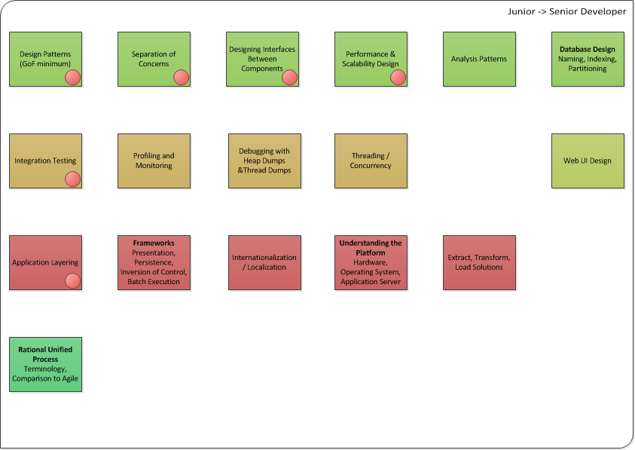
This session is part of the Architect Training curriculum
DRAFT: For Discussion Purposes Only

Slide 5
Agenda
Basic UI Principles
CSS Fundamentals
Tools and Tricks
Further Study Topics
DRAFT: For Discussion Purposes Only

Slide 6

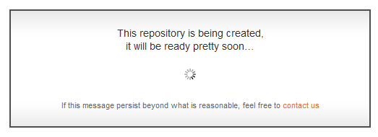
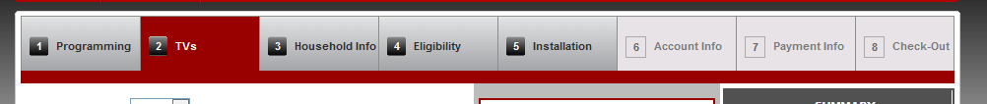
10 things I hate about you: (from Jakob Nielsen)
1) Visibility of System Status
The system should always keep users informed about what is going on, through appropriate feedback within reasonable time.
DRAFT: For Discussion Purposes Only
Source: Jakob Nielsen http://useit.com

Slide 7
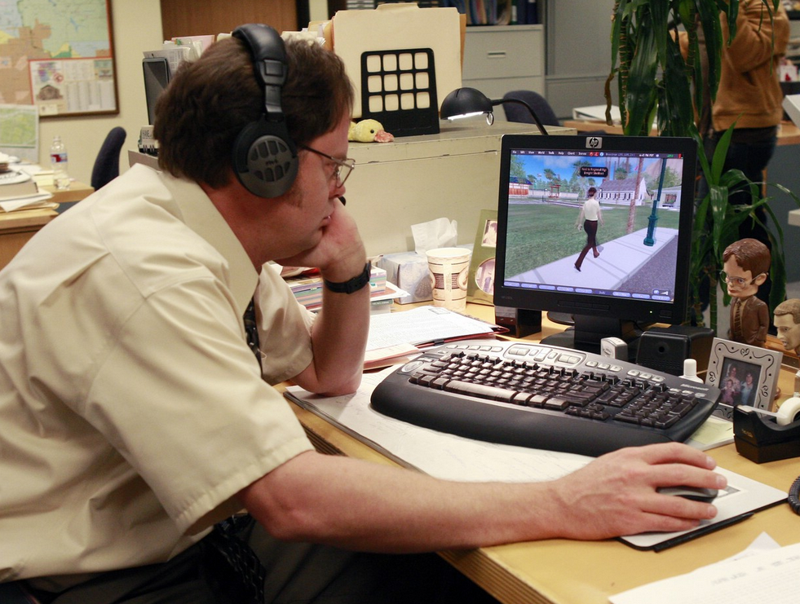

2) Match System to the Real World
The system should speak the users' language, with words, phrases and concepts familiar to the user, rather than system-oriented terms. Follow real-world conventions, making information appear in a natural and logical order.
DRAFT: For Discussion Purposes Only
Source: Jakob Nielsen http://useit.com

Slide 8
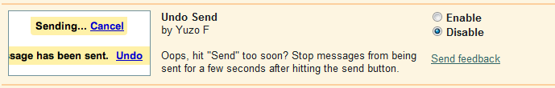
3) User control and freedom (emergency exit, undo)
Users often choose system functions by mistake and will need a clearly marked "emergency exit" to leave the unwanted state without having to go through an extended dialogue. Support undo and redo.
DRAFT: For Discussion Purposes Only
Source: Jakob Nielsen http://useit.com

Slide 9
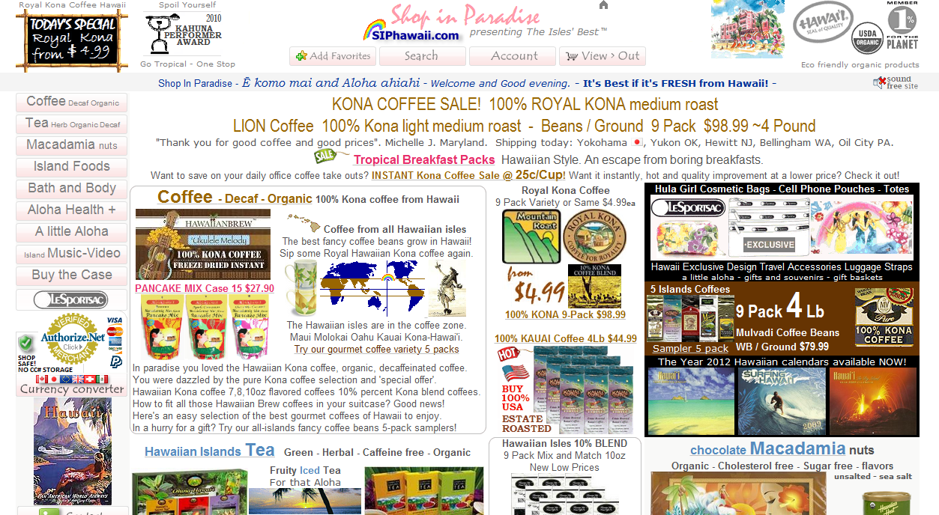
4) Consistency and Standards
Users should not have to wonder whether different words, situations, or actions mean the same thing. Follow platform conventions.
DRAFT: For Discussion Purposes Only
Source: Jakob Nielsen http://useit.com

Slide 10
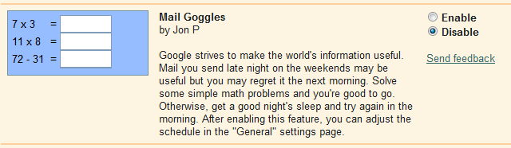
5) Error prevention
Even better than good error messages is a careful design which prevents a problem from occurring in the first place. Either eliminate error-prone conditions or check for them and present users with a confirmation option before they commit to the action.
DRAFT: For Discussion Purposes Only
Source: Jakob Nielsen http://useit.com

Slide 11
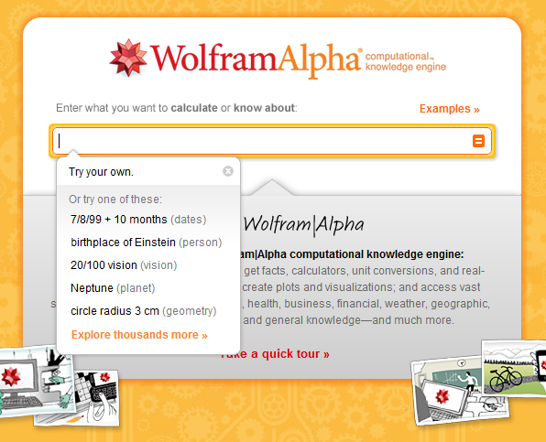
6) Recognition rather than recall
Minimize the user's memory load by making objects, actions, and options visible. The user should not have to remember information from one part of the dialogue to another. Instructions for use of the system should be visible or easily retrievable whenever appropriate.
DRAFT: For Discussion Purposes Only
Source: Jakob Nielsen http://useit.com

Slide 12
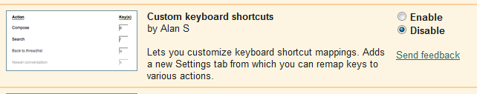

7) Flexibility and Efficiency
Accelerators -- unseen by the novice user -- may often speed up the interaction for the expert user such that the system can cater to both inexperienced and experienced users. Allow users to tailor frequent actions.
DRAFT: For Discussion Purposes Only
Source: Jakob Nielsen http://useit.com

Slide 13
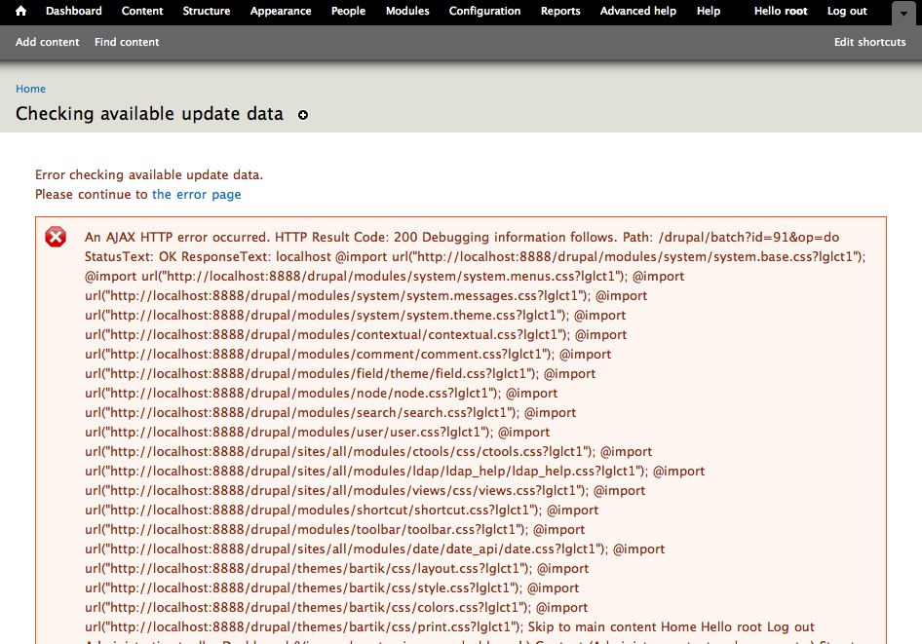
8) Minimalist
Dialogues should not contain information which is irrelevant or rarely needed. Every extra unit of information in a dialogue competes with the relevant units of information and diminishes their relative visibility.
DRAFT: For Discussion Purposes Only
Source: Jakob Nielsen http://useit.com

Slide 14
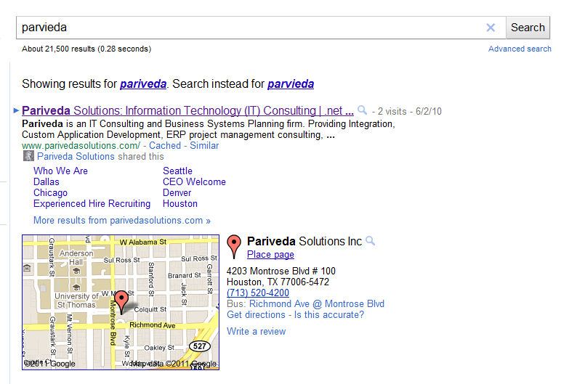
9) Help users recognize/recover from errors
Error messages should be expressed in plain language (no codes), precisely indicate the problem, and constructively suggest a solution.
DRAFT: For Discussion Purposes Only
Source: Jakob Nielsen http://useit.com

Slide 15

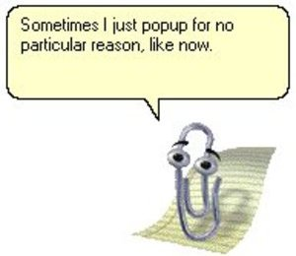
10) Help and documentation (focused on the users task)
Even though it is better if the system can be used without documentation, it may be necessary to provide help and documentation. Any such information should be easy to search, focused on the user's task, list concrete steps to be carried out, and not be too large.
DRAFT: For Discussion Purposes Only
Source: Jakob Nielsen http://useit.com

Slide 16



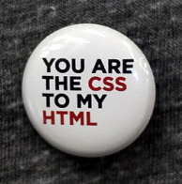
Web Display Technologies
Adobe Flash/Flex/Air
  Requires browser plugin
  Originally designed for vector animation
  Commonly used to display video and other DRM protected media
  Can be used for rich application development
  Open source variant (Flex) has good compatibility with proprietary flash
  Difficult to integrate flash and non-flash page content, poor on mobile devices
Java Applets
  Requires browser plugin and Java JRE
  Full java bytecode running on a page – ability to do anything java can (3d accelerated graphics, ftp client, etc.)
  Difficult to integrate java and non-java page content, not supported on mobile devices
  Can require large downloads
Microsoft Silverlight
  Requires browser plugin
  A subset of WPF functionality within the browser
  Open source variant (Moonlight) has poor compatibility with proprietary Silverlight
  Difficult to integrate Silverlight and non-Silverlight page content, not supported on mobile devices
HTML/JavaScript/CSS
  Standard display technology on the web
  Lightweight, flexible and open
  Supported on any device that connects to the web – many mobile devices today have better HTML/CSS support than the average desktop computer
DRAFT: For Discussion Purposes Only

Slide 17
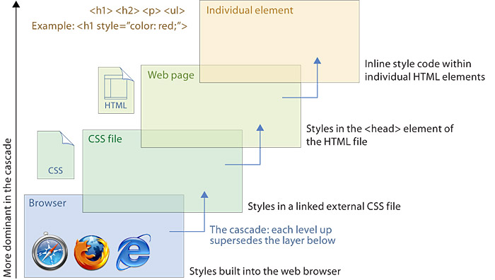
Cascading Style Sheets
Before CSS: <center><font face="verdana" color="green"><b>This</b> is <i>some</i> text!</font></center>
The style of an element is derived from a hierarchy of defined or implicit styles. In general, more specific styles carry more weight.
Use !important and :inherit to change the way styles are cascaded
How Styles Cascade
Source: http://webstyleguide.com/wsg3/5-site-structure/3-site-file-structure.html
DRAFT: For Discussion Purposes Only

Slide 18
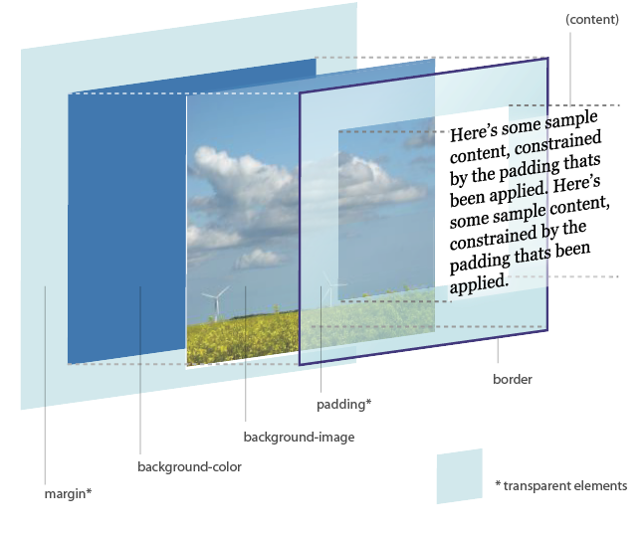
The DOM / CSS Box Model – This isn’t like desktop programming (and that’s ok)
Document Object Model
  Originally designed for displaying documents
  Starts from the top (left) and moves down
  Can be very fluid horizontally and vertically
  see: http://www.hicksdesign.co.uk/
  Valid usage of elements is defined by the World Wide Web Consortium (W3C), an international standards body led by Tim Berners-Lee
  Each element can have a class and id attribute, other attributes as defined by the element type, and sometimes other nested elements or text
CSS Box Model
  Every element in an html page is a rectangular box
  Width/Height = content+padding+border
  Margin affects how close other elements can come, and is transparent
  Padding resides inside the border and takes on the background of the box – it adds to the width/height of the box
  If undeclared, values default to 0 or the browser default for the element
CSS Box Model
Source: http://www.hicksdesign.co.uk/boxmodel/
DRAFT: For Discussion Purposes Only

Slide 19


ID vs. Class
ID
  Represented by a pound or hash sign in CSS [#ID]
  The ID tag should uniquely identify an element in the DOM (no sharing)
  An element should only have one ID (no spaces)
Class
  Represented by a period in CSS [.Class]
  Many elements can share the same class
  An element can have multiple classes [class=“firstClass secondClass”]
Both can be used to assign styles
  Use classes to define general, reusable templates
  Use IDs when you want the style to only apply to a specific element
  Most CSS uses classes much more than IDs
?
(Tim Berners Lee)
(David Morris)
DRAFT: For Discussion Purposes Only

Slide 20
CSS Selectors
Pattern matching rules (called selectors) determine which styles apply to which elements
CSS properties are defined using the form:
SELECTOR { style:definition; style:definition; }
In general, more specific selectors override styles from less specific properties
Pattern | Meaning | Type
* | Matches any element | Universal Selector
E | Matches any element of type E | Type Selector
E F | Matches any F that is a descendant of E | Descendant Selector
E > F | Matches any F that is a direct child of E | Child Selector (IE 7+ only)
E + F | Matches any F directly preceded by E | Sibling Selector (IE 8+ only)
E.class | Matches any E with the given class | Class Selector
E#id | Matches any E with the given id | ID Selector
E:state | Matches any E in the given state (ie :link, :visited, :active, :hover, :focus) | Pseudo-class Selector (Browser support depends)
E[attribute=“value”] | Matches any E with the given attribute | Attribute Selector (IE 7+ only)
DRAFT: For Discussion Purposes Only

Slide 21
CSS Selectors (Continued)
Examples:
body { … }
div { … }
div span { … }
p > span { … }
li + li { … }
#header { … }
div.content { … }
.nav li div a, .nav li div a:link, .nav li div a:visited { }
CSS Best Practices
Add extra elements sparingly
Add classes thoughtfully
Avoid descendent selector kludge
Source: http://www.slideshare.net/nathansmith/refresh-okc
DRAFT: For Discussion Purposes Only

Slide 22
CSS Properties
The styles applied by a selector are defined by a list of properties
There are dozens of possible properties which can be applied
Some common examples:
background-color: blue;
border: 2px solid black;
color: white;
display: inline;
font-family: sans-serif;
font-weight: bold;
height: 100em;
margin: 2%;
overflow: hidden;
padding: 5px;
text-indent: 10pt;
visibility: hidden;
width: 50%;
W3C official list - http://www.w3.org/TR/CSS21/propidx.html
DRAFT: For Discussion Purposes Only

Slide 23
Shortcuts
Many CSS properties can be written in multiple ways
This allows you to pick the shortest version for what you need, decreasing your overall download size
For example:
  You could write:
  border-top-width: 1px;
  border-top-style: solid;
  border-top-color: red;
  OR
  border-top:1px solid red;
Because every element is a box, many properties have Top, Right, Bottom, and Left versions:
  margin-top: 5px;
  margin-bottom: 10px;
  margin-right: 15px;
  margin-left: 20px;
You can combine them into a single property. Use the mnemonic TRouBLe to remember the order
  margin: 5px 15px 10px 20px;
2 value version: TOP/BOTTOM, RIGHT/LEFT
  margin:5px 50px;
3 value version: TOP, RIGHT/LEFT, BOTTOM
1 value version applies to all sides equally:
margin:5px;
DRAFT: For Discussion Purposes Only

Slide 24
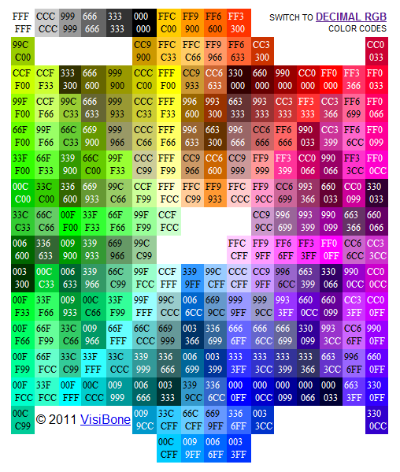
Colors
By Name
  border-color:black;
  color:aquamarine;
  List of 17 standard colors plus 130 additional usable colors
Explicit RGB
  rgb(255, 255, 0);
  rgb(123, 4, 22);
  rgb(50%, 60%, 40%);
By RGB Hex Hash (most common)
  #ffffff;
  #fffcc2;
  #ccc;
  #769c54;
Alpha Channel (transparency) in CSS3
http://kuler.adobe.com/
http://www.colourlovers.com/
http://www.colorpicker.com/
Hex Color Map
Source: http://html-color-codes.com/
DRAFT: For Discussion Purposes Only

Slide 25
Tables
Before CSS was commonly supported, the only way websites could create complex layouts was by abusing the table element
As a result, many legacy websites and content management systems make heavy use of tables for layout purposes
Why Not Tables?
  Tables are usually more bytes of markup (Longer to download, and more bytes of traffic for the host)
  Tables usually prevent incremental rendering (Takes longer for the user to see anything on the page)
  Tables may require you to chop single, logical images into multiple ones (This makes redesigns total hell, and also increases page load time [more http requests and more total bytes])
  Tables break text copying on some browsers (That's annoying to the user)
  Tables prevent certain layouts from working within them (like height:100% for child elements of <td>, they limit what you can actually do in terms of layout)
  Once you know CSS, table-based layouts usually take more time to implement (A little effort up-front learning CSS pays off heavily in the end)
  Tables are semantically incorrect markup for layout (They describe the presentation, not the content)
  Tables make life hell for those using screen readers (Not only do you get the other benefits of CSS, you're also helping out the blind/partially-sighted. This is a Good Thing)
  Tables lock you into the current design and make redesigns MUCH harder than semantic HTML+CSS (Have you seen CSS Zen Garden?)
  Source: http://phrogz.net/css/WhyTablesAreBadForLayout.html
Do use tables:
  When you are presenting tabular data
  If you need to support IE5 or earlier
DRAFT: For Discussion Purposes Only

Slide 26
Inline vs. Block
All HTML elements are naturally displayed in one of the following ways:
display:inline
  Takes up only as much width as it needs, and does not force new lines
  Inline-display elements don’t break the flow
  They fit in with the flow of the document
  Examples: <span> <a> <strong> <b> <em> <img> <br> <input> <textarea> <button>
display:block
  Takes up the full width available, with a new line before and after
  A block-display element will span the full width of the space available to it, and so will start on a new line in the flow of HTML
  The flow will continue on a new line after the block-display element
  Examples: <div> <h1> <p> <ul> <ol> <table> <pre>
display:none
  Not visible, takes up no space
  As opposed to visibility:hidden; that is not visible but takes up space
  Examples: <meta> <style>
Any element can have its display property overridden
Source: http://www.webdesignfromscratch.com/html-css/css-block-and-inline/
DRAFT: For Discussion Purposes Only

Slide 27
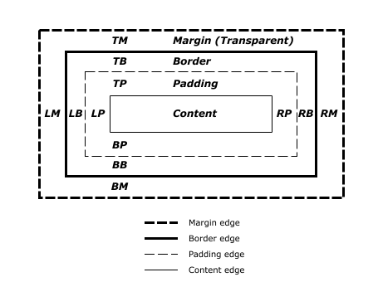
Padding-Border-Margin
W3C Box Specification
Source: http://www.w3.org/TR/CSS21/box.html
For inline elements: Width and height do not apply, while margin and padding do not effect surrounding elements vertically
DRAFT: For Discussion Purposes Only

Slide 28
Units of Measure – px, pts, ems, %
You can measure CSS property values in one of two ways:
As an absolute value
As a relative value
Absolute values have a fixed, specific value. They let you, the page creator, be exact in your measurements and control the display of your Web pages.
  Example: The font size might be 14 point
  When you are using absolute values always remember that the reader might be viewing your page in a different environment from what you expect
Relative values have no fixed, specific value. Rather, they are calculated in comparison to a current value
  Example: Type size might be larger, smaller, bolder, or lighter. Indent might be specified in em spaces, which vary with the display size of the text
  Because Web pages are viewed in so many different ways, it is often a good idea to use relative values
  It gives you less absolute control but it often creates a better experience for your readers and lets your page flow dynamically
Source: http://www.devx.com/projectcool/Article/19850
Absolute Units
unit | abbrev | example
points | pt | font-size: 12pt There are 72 points to an inch, 12 points to a pica.
picas | pc | text-indent: 2pc There are 6 picas to an inch.
centimeters | cm | text-indent: 4cm
inches | in | text-indent: 1in
millimeters | mm | text-indent: 8cm
Relative Units
unit | abbrev | example
pixels | px | text-indent: 30px A pixel is one picture element on the display monitor; there are typically between 72 and 90 pixels/inch.
em space | em | text-indent: 4em An em space is the width and height of the capital letter M in the current font size and design.
x space | ex | line-height: 3ex
percentage of parent's value | XX% | font-size: 90%
Bold units are the most common
DRAFT: For Discussion Purposes Only

Slide 29
Position – Absolute vs. Relative
The position property (as you may have guessed) changes how elements are positioned on your webpage
position: static;
  Static positioning is by default the way an element will appear in the normal flow of your HTML file
  It is not necessary to declare a position of static
  Doing so, is no different than not declaring it at all
position: relative;
  Positioning an element relatively places the element in the normal flow of your HTML file and then offsets it by some amount using the properties left, right, top and bottom
  This may cause the element to overlap other elements that are on the page, which of course may be the effect that is required
position: absolute;
  Positioning an element absolutely, removes the element from the normal flow of your HTML file, and positions it to the top left of its nearest parent element that has a position declared other than static
  If no parent element with a position other than static exists then it will be positioned from the top left of the browser window
  Can use z-index to change which element is on top
  IE6 has some absolute positioning bugs
position: fixed;
  Positioning an element with the fixed value, is the same as absolute except the parent element is always the browser window
  It makes no difference if the fixed element is nested inside other positioned elements
  Fixed position is not supported in older browsers such as IE6
  Source: http://www.cssbasics.com/css-positioning/
DRAFT: For Discussion Purposes Only

Slide 30
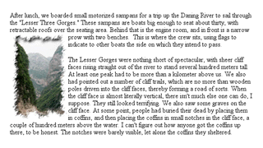
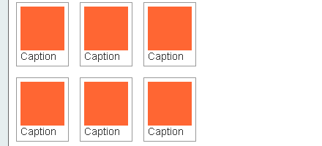
Float (and Clear)
What are floats?
  A float is simply a box (for example, a div) that is shifted to the left side or the right side of its container
  We then say that the box is floated left or floated right
  One of the key benefits of floats is that they allow you to have bits of content sitting side by side, rather than one below the other
Rules to remember
  If you want to have a right-floated box, you need to put the HTML for the floated box before the non-floated content (not after as you might expect)
  In the original CSS version 2 spec you had to specify a width for all floated elements (though the width could be relative, such as a percentage width)
  In the new CSS2 spec, however, an explicit width is not required
  If you need to have content after a float that shouldn't run alongside the float, use the clear property (on a following element)
    clear:right;
    clear:left;
    clear:both;
Source: http://www.elated.com/articles/css-floats/
Float Examples
DRAFT: For Discussion Purposes Only

Slide 31
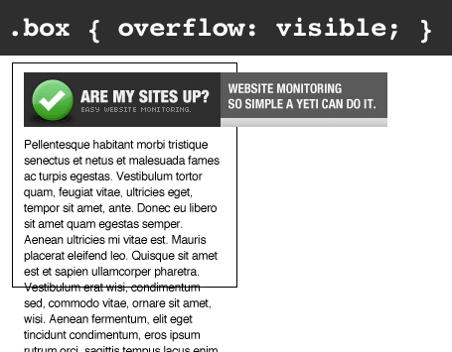
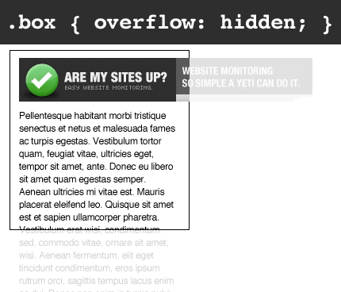
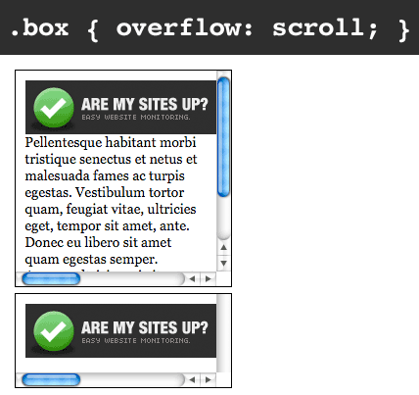
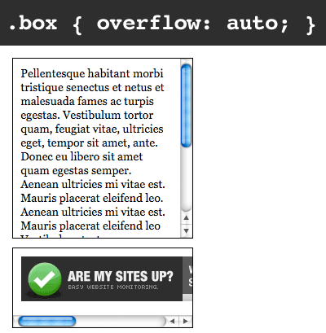
Overflow
Types of Overflow
The overflow declaration tells the browser what to do with content that doesn't fit in a box.
  This assumes the box has a height
  If it does not, it becomes as high as necessary to contain its contents, and the overflow declaration is useless.
You can assign four values to overflow and they should give the following results:
visible: the content flows out of the box
hidden: the overflowing content is completely hidden, not accessible to the user
auto: show scrollbars where necessary (horizontal or vertical or both)
scroll: always show horizontal and vertical scrollbars, regardless of whether they're necessary (This value is never used; you generally want auto)
Source: http://www.quirksmode.org/css/overflow.html
Note: scroll bars cannot be styled
DRAFT: For Discussion Purposes Only

Slide 32
Tricks and Tools
Ul li menu
Absolute Header/Footer
960 grid
Image tricks (background images, sprites)
Optimizing images for the web
Cross Browser Tricks/Hacks
Theming SharePoint 2010
Meta CSS
Cache Refresh
DOM inspection tools
Web Developer Toolbar
Image Editing Tools
W3C validation
User Analytics
Page load optimization
Download the slides, get the demos at
derrickbowen.com/web-ui-demo
DRAFT: For Discussion Purposes Only

Slide 33

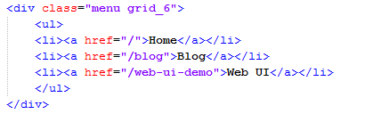
Tricks – ul li menu
An unordered list is a logical and flexible way to present a menu in HTML
Lists by default run vertically, but it is a simple matter to have the menu run horizontally using CSS
The technique involves floating the <li> elements, and adding padding for width
See example 3 in the demo
ul li Example
DRAFT: For Discussion Purposes Only

Slide 34
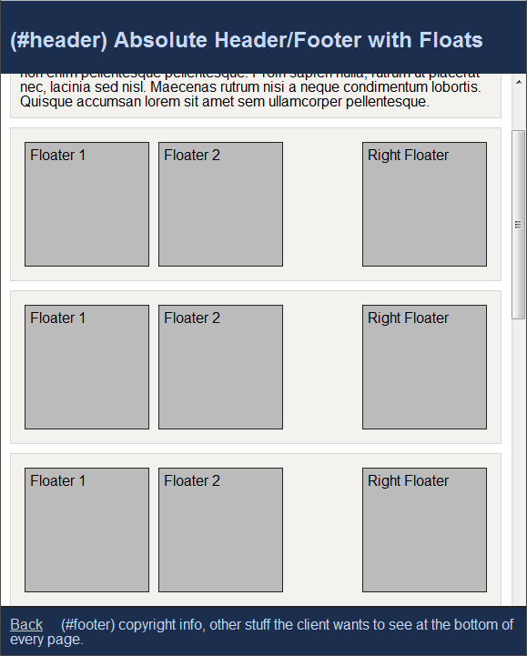

Tricks – Absolute Header/Footer
A header and/or footer that stay on the page as you scroll can help your site feel more like an application
This technique uses
  three main div elements to divide the page into sections,
  position:absolute to align the sections vertically
  overflow:auto to allow the middle section to scroll
See example 4 in the demo
Absolute Header/Footer Example
Condensed HTML Code
DRAFT: For Discussion Purposes Only

Slide 35
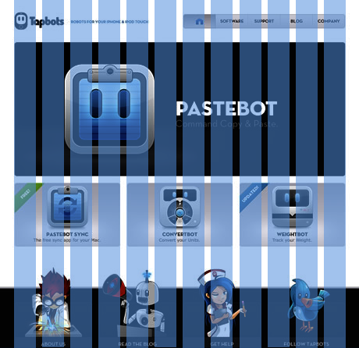
Tricks – 960 Grid
A carry over from traditional print media, organizing your content on a grid helps to keep things looking sharp and uncluttered
Usually 12 or 16 columns
Most often centered, but can be right or left justified.
Fixed width grids
  A set number of pixels wide, such as 960px, 800px of 1024px
  Easier to use image backgrounds with horizontal gradients or clip art
  Can end up with a lot of wasted space on larger screens
Fluid width grids
  Column widths based on percent rather than pixels
  Hard to get images such as horizontal gradients or clip art to look right at every screen width
  No wasted space on large screens.
http://960.gs/ - a free, flexible css grid framework used by a number of popular websites.
See example 5 in the demo
960 Grid Example
DRAFT: For Discussion Purposes Only

Slide 36
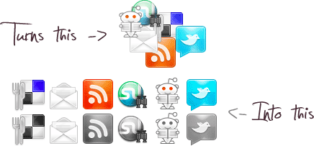
Tricks – Image Tricks
Using images increases the visual appeal and capabilities of CSS, but also increases the page download size
Background image
  DOM elements can have their background set to an image rather than just a color
  Can be set to scroll with the page, or stay fixed in place
Sprites
  The technique of combining multiple images into a single image
  Use background positioning and a fixed width to only show the desired portion of the super image
  Decreases per page downloads and page load time
  Prevents images from “blinking”
  Many automated tools available
Sliding Door
  A trick using 2 background images to create a symmetrical, variable width style
  Common for creating rounded tabs, fancy menu items, etc.
Favicons
  Modern browsers allow you to specify an icon for the web site
  This icon is displayed in the tab bar, and when creating a desktop shortcut
  <link rel="SHORTCUT ICON" href="img/favicon.ico" />
  <link rel="icon" type="image/vnd.microsoft.icon" href="img/favicon.ico" />
See example 6 in the demo
Image Sprite Consolidation
Source: http://css-sprit.es/
Sliding Door Technique
Source: http://www.alistapart.com/articles/slidingdoors/
DRAFT: For Discussion Purposes Only

Slide 37
Tricks – Optimizing images for the web
Images are the largest automatically downloaded resources on a website
Fine tuning the images on a page is important for getting your page to download quickly and to feel responsive
Image Filetypes:
BMP – Bitmap – Uncompressed! Do not use on web pages.
JPG – Lossy format good for photos and photorealistic images
PNG – Lossless format, ZIP compressed – good for page elements and clipart style icons
GIF – Old format, use PNGs unless you want cheesy animations
Image Tuning
Image resizing / Aspect ratio
  Size your images to the size they will be displayed in an image editor, not using height/width on the HTML element
  Resizing in the browser looks terrible and increases download size
  Be careful not to stretch the image horizontally or vertically when you resize it
MYTH: GIFs are smaller than PNGs
  PNGs are usually smaller than GIFs when properly fine tuned
  In Photoshop or The GIMP, set the color mode to indexed – The file will be limited to 256 unique colors, but the file size will be dramatically reduced
  Remove the alpha (transparency) layer if you are not using it
See example 6 in the demo
DRAFT: For Discussion Purposes Only

Slide 38
Tricks – Cross browser tricks/hacks/conditional stylesheets
Start your style with a CSS reset - http://meyerweb.com/eric/tools/css/reset/
Child Selectors
  IE6 ignores them, so you can use it for valid, browser conditional styles
W3C validation
  Many browser compatibility issues occur because browsers handle invalid html/css differently. If you aim for W3C validated code you will have fewer problems
  You can use the Web Developer Toolbar to validate HTML on your localhost or behind a firewall, or directly copy and paste it to the W3C validator here: http://validator.w3.org/#validate_by_input
IE conditional stylesheets
  Microsoft has implemented a feature so you can serve different css based on the browser version:
  <!--[if IE 6]>
  <link rel="stylesheet" href="ie6.css" media="all">
  <![endif]-->
Use a DOCTYPE at the top of your page
  for HTML5: <!DOCTYPE html>
  Using a doctype puts the browser in Standards Compliance mode instead of Quirks Mode
  Should be the first element on the page, before even the <html> tag
Test your pages in different browsers regularly as you develop
  http://www.my-debugbar.com/wiki/IETester/HomePage
  http://utilu.com/IECollection/
  http://tredosoft.com/Multiple_IE
http://universal-ie6-css.googlecode.com
http://www.position-absolute.com/articles/css-for-ie6-6-common-problems-and-fast-ways-to-fix-them/
DRAFT: For Discussion Purposes Only

Slide 39
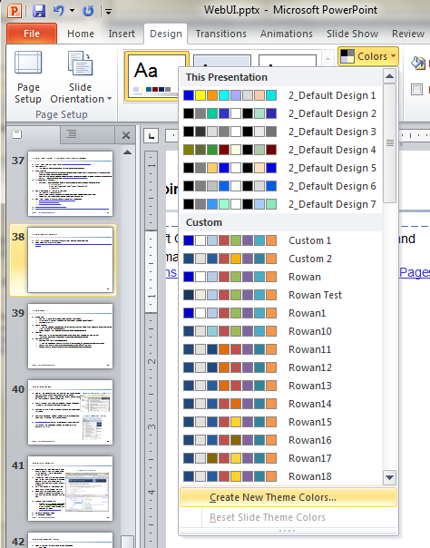
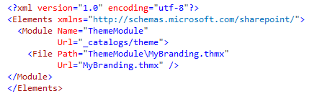
Tricks – Theming SharePoint
Build a Microsoft Office Theme
  This can be done in PowerPoint
  Save the theme as a thmx file and import it into SharePoint in a module
  By Starting from here, you will be working with SharePoint when designing your theme rather than against it
Start with a built in SharePoint 2010 masterpage, and modify it to meet your needs
  Add CSS links, CSS classes, move page elements around, etc.
  Shows you what you MUST have on the masterpage and helps you avoid errors
  V4 or minimal are good general master pages to start with, and you will need a separate my site master page if you are using them
Add theme CSS files, images, etc.
  SharePoint CSS colors can be set to the values from the current theme: http://www.wictorwilen.se/Post/Creating-custom-themable-CSS-files-for-SharePoint-2010.aspx
  Add images by including the SharePoint “Images” mapped folder in your Visual Studio project.\
Veda Page with more information: http://veda.parivedasolutions.com/knowledge/technology/sharepoint/Pages/BrandingThemingSharepoint2010.aspx
DRAFT: For Discussion Purposes Only

Slide 40
Tricks – Meta CSS
Media Tag
  Can set styles to only be used in certain scenarios (print/screen)
  <LINK REL="stylesheet" TYPE="text/css" MEDIA="print, handheld" HREF="foo.css">
  @media print { … }
Name Spacing
  If you are working in an environment with css from a lot of sources, adding a short word with a dash or underscore in front of your styles is common/helpful
  Avoids collisions, but too long of namespaces can increase download size
@import
  Allows you to put common styles or templates into separate files and import just what you want
  Increases organization, path complexity, and number of downloads per page
CSS compression
  Combine CSS files into a single download
  If you are working on a site with a lot of traffic, or where bandwidth is precious, use shorter class names
  Some sites take this a step further and use automated tools to “minify” their CSS
  Replace descriptive class names with short unique random character combinations
DRAFT: For Discussion Purposes Only

Slide 41
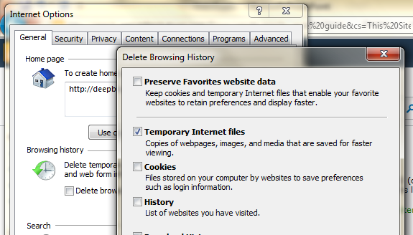
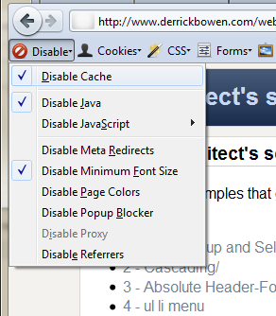
Tools – Cache Refresh
One of the benefits of CSS files how well they can be cached. This can cause some heartache as you are actively developing your styles. Find out how to clear the CSS cache on the browsers you are testing with.
Every browser has an option hidden in the menu someplace to delete the cache, or temporary internet files
Pressing Ctrl-F5 in most browsers will cause the page to do a full reload
The Web Developer Toolbar addon for Firefox and Chrome allows you to disable the browser cache
http://livejs.com/ - scriptlet for developers that automatically refreshes the page when changes are detected in css, javascript or html
Deleting Temporary Files in IE
Firefox Developer Toolbar
DRAFT: For Discussion Purposes Only

Slide 42
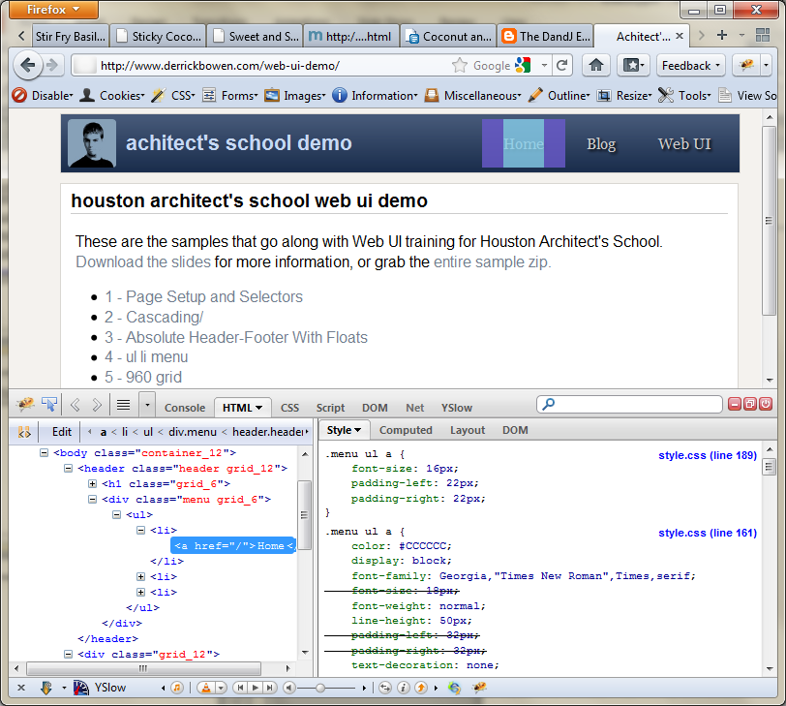
Tools – DOM Inspection
DOM inspection tools allow you to view exactly which styles are being applied to an element, and to add/remove styles on-the-fly
Inspection tools are the most effective way to get CSS properties to have the desired effect on a page, and to understand how CSS properties work in general
Lets you design in the browser from which users will be viewing the site
Once you are used to how it works, it is a powerful design/prototyping tool you can use during sessions with the client
Firebug (and Firebug Lite)
  Firebug lite is a javascript bookmarklet that offers DOM inspection capabilities in any browser, without installing any add-ons or plugins
  http://getfirebug.com/firebuglite
Chrome Developer Tools
IE Developer Toolbar
Firebug in Firefox 4
DRAFT: For Discussion Purposes Only

Slide 43
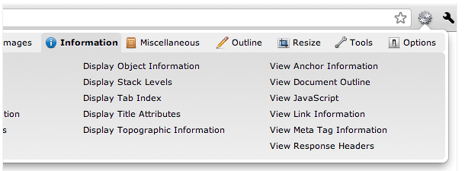
Tools – Web developer toolbar
Adds a number of useful tools for web developers
  CSS tools
  Form mass entry/automation
  Expose additional element attributes
  Ruler
  Color Picker
  Set Window to a preset size (1024x768, 800x600)
  Submit local files for W3C validation
  … etc.
Available for Firefox and Chrome
  https://addons.mozilla.org/en-US/firefox/addon/web-developer/
  http://chrispederick.com/work/web-developer/
Web Developer Toolbar for Chrome
DRAFT: For Discussion Purposes Only

Slide 44
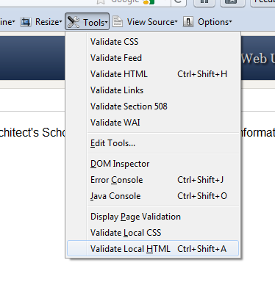
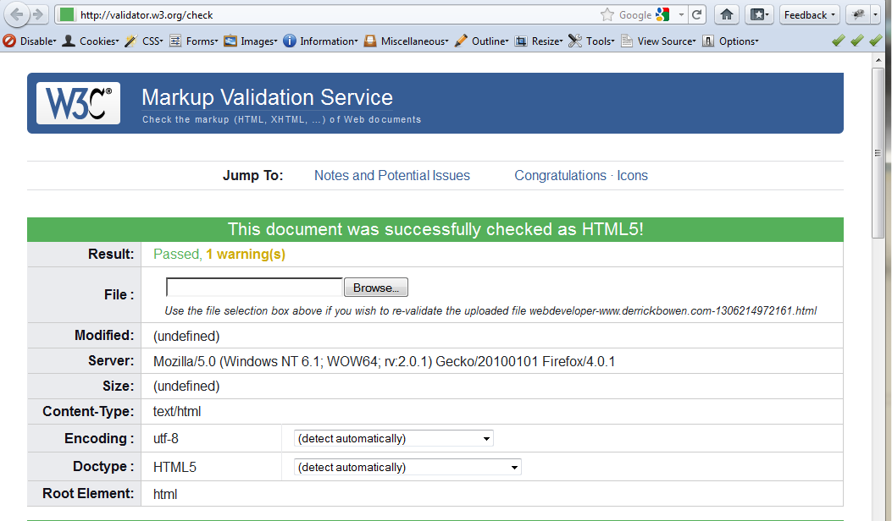
Tools – W3C validation
W3C offers free validation tools (and badges) for you to use
Validating your HTML and CSS helps to reduce display errors, cross browser issues, and future browser upgrade challenges
Validating is easy with the Web Developer Toolbar – even on local HTML and HTML behind corporate firewalls
DRAFT: For Discussion Purposes Only

Slide 45




Tools – Images
Raster Image Editors
  Photoshop
  The Gimp
  Paint.NET
Vector Image Editors
  Adobe Illustrator
  Inkscape
Icon Galleries
  Iconfinder.com – free high quality clip art and icons
  iconarchive.com
Stock Photo Galleries
  Stock Xchng - http://www.sxc.hu/index.html (free medium quality stock photos)
  iStockPhoto - http://www.istockphoto.com/
  Flickr: can filter by content license to view only royalty free images
DRAFT: For Discussion Purposes Only

Slide 46
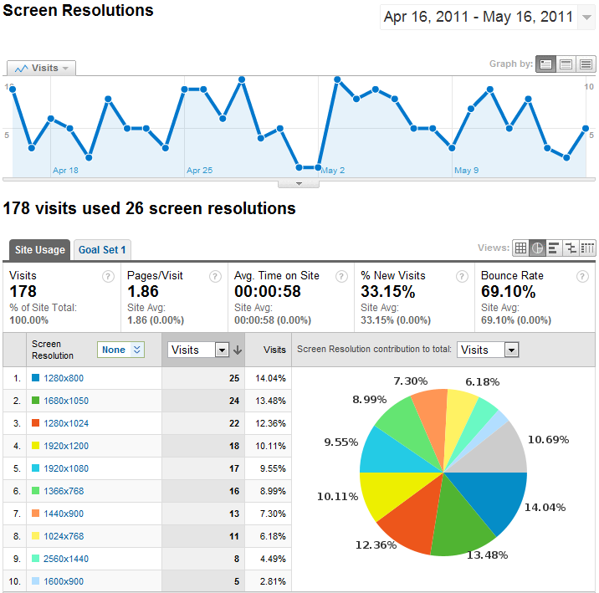
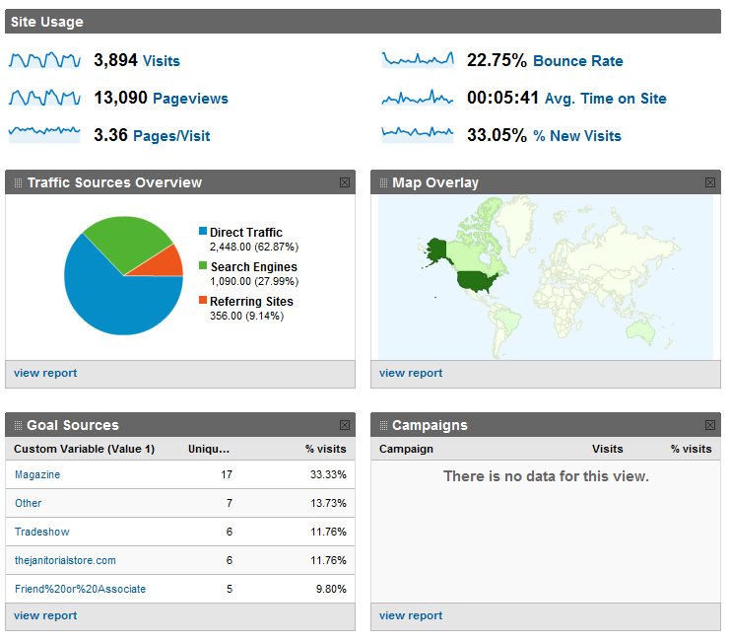
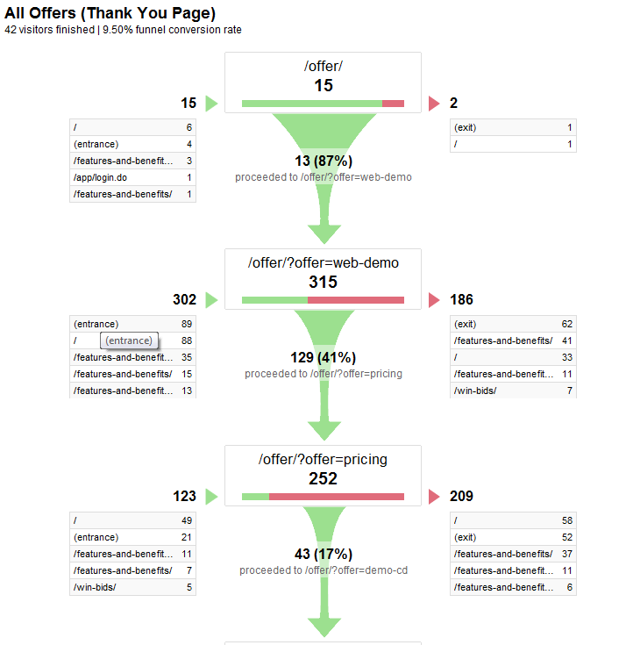
Tools – Analytics
If you are serious about web design, you must have user analytics
Analytics allow you to fail faster (so you can fix it right away
Indicators
  Visits
  Bounce Rate (leave
  after first page)
  Keywords
  Pageviews
Goals
  Specify pages and
  track entry/exit points
  Shopping Carts
Conversions
  Understand who your
  customer is and how
  they get to that point.
  Measure campaign
  effectiveness
A-B Testing
  Code 2 versions of a page, and then
  randomly show the pages to different visitors.
  Track goal conversion and genetically improve each piece of your site
Source: www.google.com/analytics
DRAFT: For Discussion Purposes Only

Slide 47
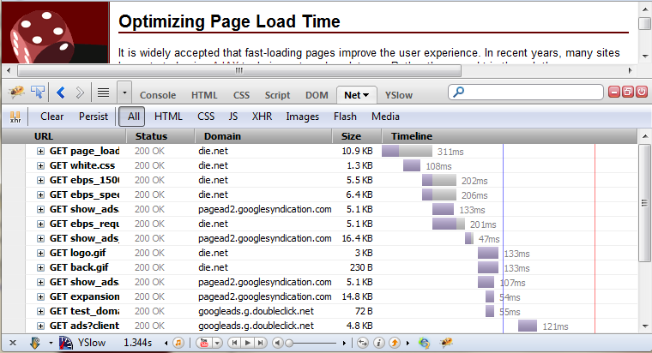
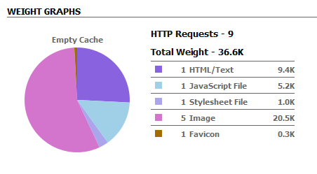
Tools – Page Load Optimization
Page optimization tools analyze your site and give tips on how to improve performance
Examples:
  Yslow
  Yahoo Developer Network page load optimization tips: http://developer.yahoo.com/performance/rules.html
  Google Page Speed - http://pagespeed.googlelabs.com/
  FireBug Net Tab
  Chrome Developer Tools
http://www.die.net/musings/page_load_time/
DRAFT: For Discussion Purposes Only

Slide 48
Further Study
Sass - http://sass-lang.com/
Less - http://lesscss.org/
Css3 - http://www.w3.org/Style/CSS/specs http://www.css3.info/
  Rounded Corners
  Shadows
  @Media Queries
  Much more
http://www.blueprintcss.org/
jQuery (jQuery UI Themeroller) - http://jqueryui.com/themeroller/
“The Fold” - A concept from web marketing that can apply elsewhere. Make the most important things easy to discover (near the top)
MWSnap - http://www.mirekw.com/winfreeware/mwsnap.html - handy snapshot tool
Backfire - save changes made in Firebug - http://blog.handcraft.com/2010/08/backfire-save-css-changes-made-in-firebug/
http://mathiasbynens.be/demo/css-without-html (view in Firefox) CSS without HTML
W3Schools != W3C - http://w3fools.com/
http://www.zdnet.com/blog/networking/browser-wars-chrome-winning-ie-losing/1119
DRAFT: For Discussion Purposes Only

Slide 49
References
http://en.wikipedia.org/wiki/Cascading_Style_Sheets
Jakob Nielson Heuristics - http://www.useit.com/papers/heuristic/heuristic_list.html
CSS Box Model - http://css-tricks.com/the-css-box-model/
W3C - http://www.w3.org/
Good description of block vs inline elements - http://www.maxdesign.com.au/articles/inline/
3d Box Model - http://hicksdesign.co.uk/journal/3d-css-box-model
Cascading order - http://webstyleguide.com/wsg3/5-site-structure/3-site-file-structure.html
Grids and CSS: http://www.slideshare.net/nathansmith/refresh-okc
Selector support - http://www.quirksmode.org/css/contents.html
Why tables are bad for layout - http://phrogz.net/css/WhyTablesAreBadForLayout.html
http://www.cssbasics.com/
http://www.webdesignfromscratch.com/html-css/css-block-and-inline/
Units of Measure - http://www.devx.com/projectcool/Article/19850
Floats - http://www.elated.com/articles/css-floats/
More on Floats - http://www.smashingmagazine.com/2007/05/01/css-float-theory-things-you-should-know/
Overflow - http://www.quirksmode.org/css/overflow.html
More on Overflow - http://css-tricks.com/the-css-overflow-property/
Ul li menu - http://www.secondpicture.com/tutorials/web_design/css_ul_li_horizontal_css_menu.html
DRAFT: For Discussion Purposes Only

